Slide 1
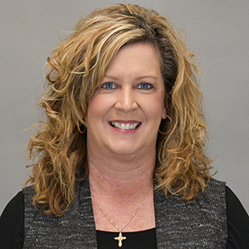

Sandhills Community College
Medical Assisting Certificate Program

Slide 2

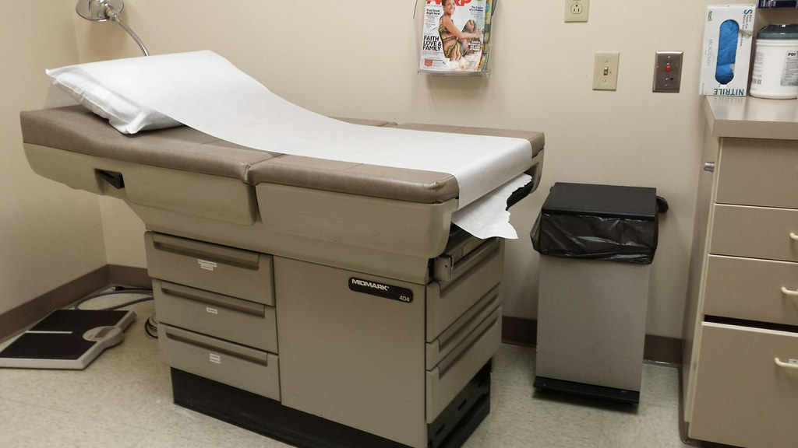
Medical Assistants are cross trained to perform administrative and clinical duties

Slide 3

The Medical Assisting Program at Sandhills Community College is delivered in three-part sections, each section must be passed to move to the next, the program takes approximately 11 months to complete:
Medical Assisting Part I – This course focuses on medical assisting administrative skills as well as anatomy, physiology, medical terminology and basic math for medical office finance and pharmacology.
Medical Assisting Part II – This course focuses on medical assisting clinical skills and prepares the student to successfully participate in the Practicum/Clinical Part III.
Medical Assisting Part III – This course serves as the students Practicum/Clinical experience, this section is 160 hours and completed under the supervision of a preceptor in a local outpatient or ambulatory clinic setting (unpaid)

Slide 4
Medical Assisting Program Goals
Prepare competent entry-level medical assistants in the cognitive (knowledge), psychomotor (skills), and affective (behavior) learning domains. Students must pass 100% of all competencies in the MA program and in the Master Competency List within 3 attempts to be able to progress in the MA program.
To help students’ complete competencies as required by our program.
To teach effective communication and patient advocacy.
To help students understand and practice health safety policies and procedures and provide quality patient care.
To help students to demonstrate professionalism, understanding and compassion while serving diverse populations.
Prepare students for immediate employment as a medical assistant.

Slide 5
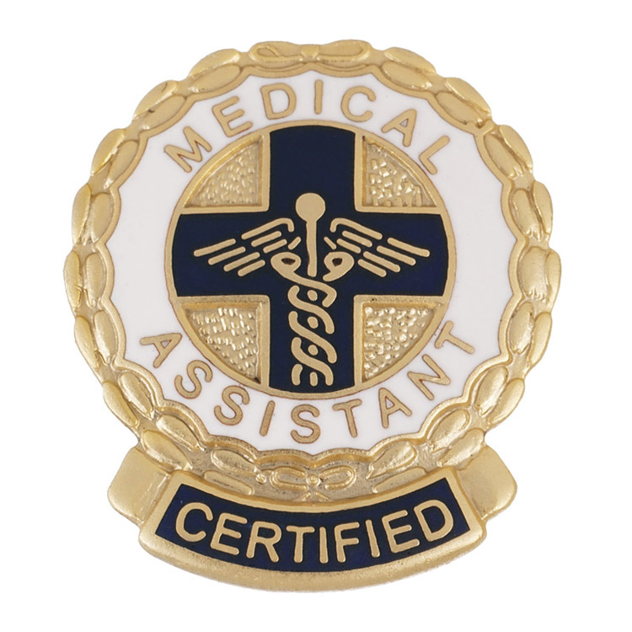

Accreditation Status
The Medical Assisting Program at Sandhills Community College is accredited by:
Commission on Accreditation of Allied Health Education Programs
25400 US Highway 19 North, Suite 158
Clearwater, FL 33763
(727) 210-2350
Upon the recommendation of the Medical Assisting Education Review Board (MAERB). Graduates of CAAHEP accredited medical assisting program may be eligible to sit for the American Association of Medical Assistants’ (AAMA) Certification Examination to become Certified Medical Assistants, CMA (AAMA).
American Association of Medical Assisting Endowment
20 N. Wacker Dr., Ste. 1575
Chicago, IL 60606
(312) 899-1500
Students who successfully pass the MA program are also eligible to sit for the Registered Medical Assistant (RMA) with American Medical Technologies (AMT).
This Photo by Unknown Author is licensed under CC BY-NC

Slide 6

How do you apply?
Please email me with your interest in the program at morganm@sandhills.edu
Once I receive your email of intent to apply, I will ask for a copy of the following:
High school diploma
Any and all college transcripts
Copies of immunizations from birth to present
I will review your information
English and Math are vital in the program
If you need additional testing for entry, it may include WorkKeys Documents and WorkKeys Math the scores must be 4 or higher on either or both – depends on past credits and grades
Last step, interview with me to discuss program and answer any questions you may have

Slide 7

Any questions? Please email me at morganm@sandhills.edu or call 910-695-3913

