Slide 1
Future Growth at the
Sandhills Community College Hoke Center

Slide 2


Slide 3
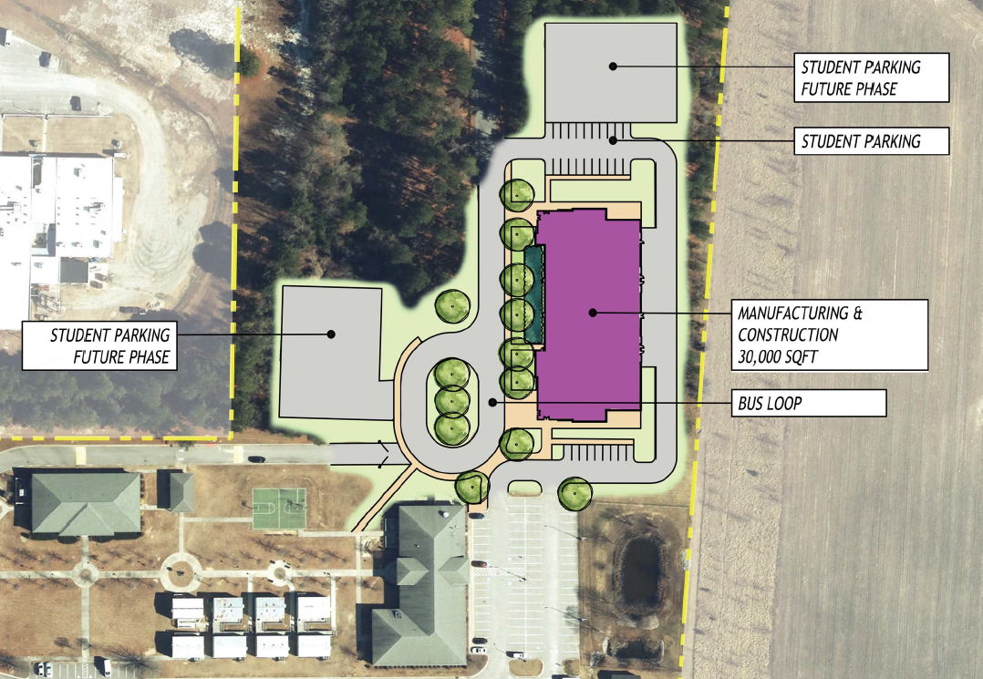

Slide 5
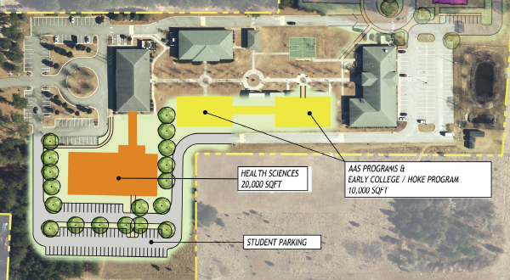

Slide 7
